Slide 1
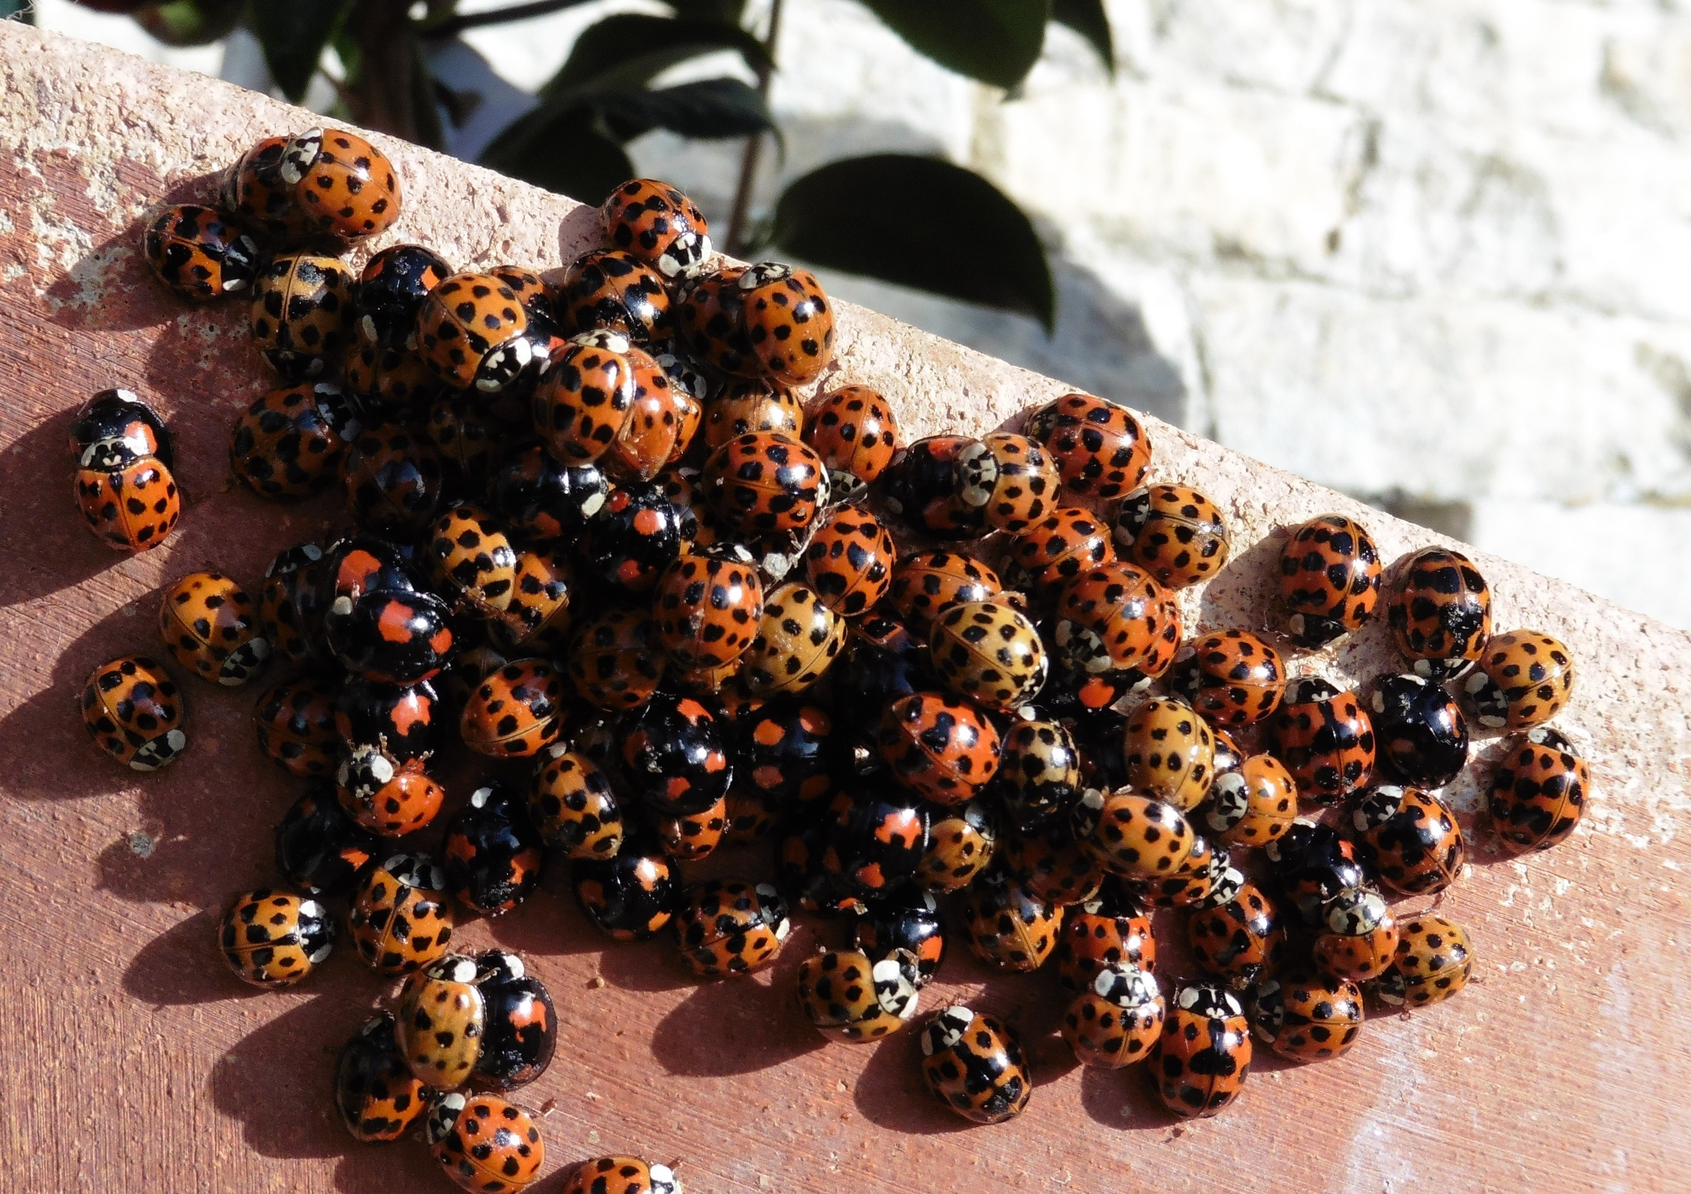
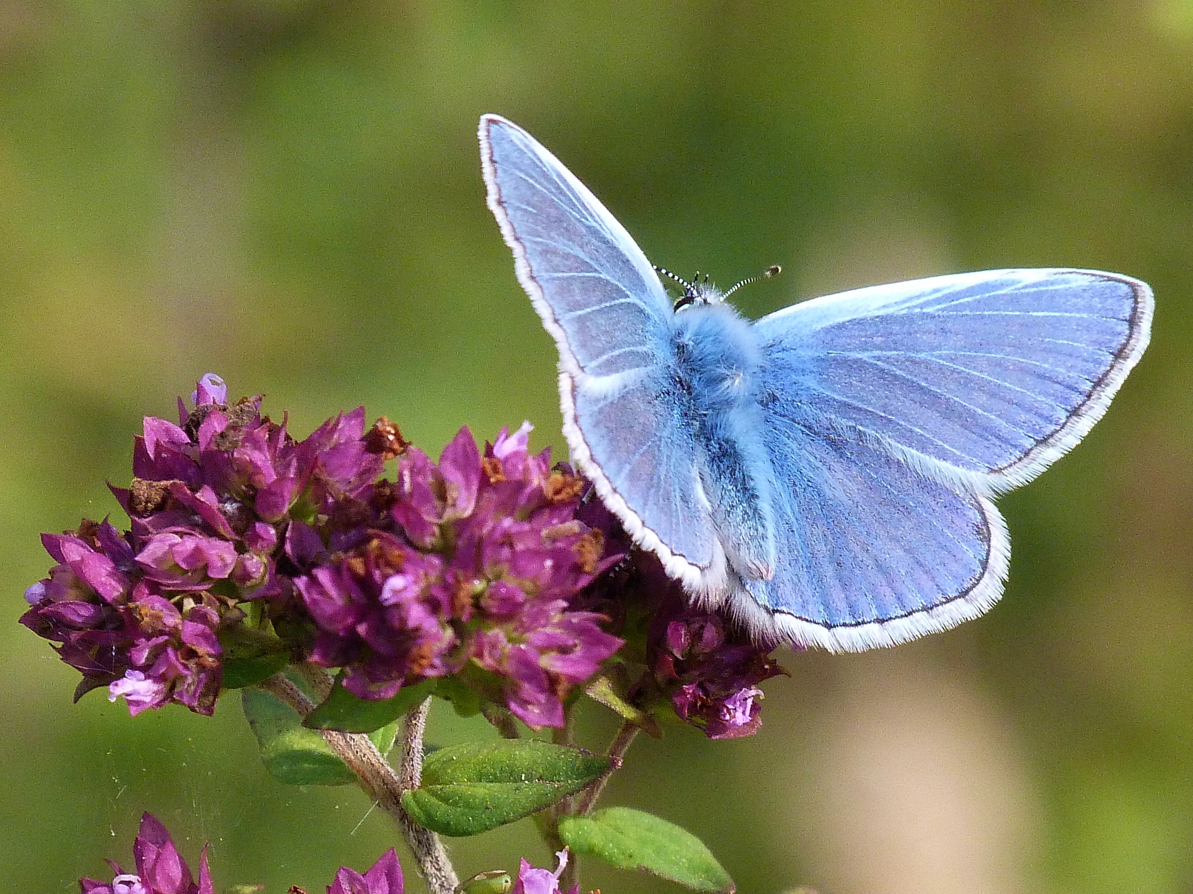
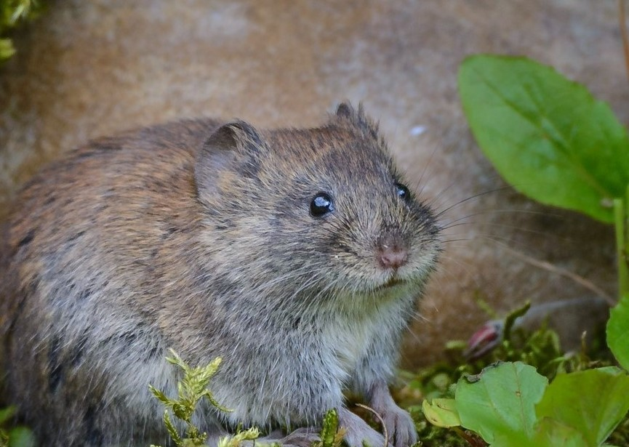
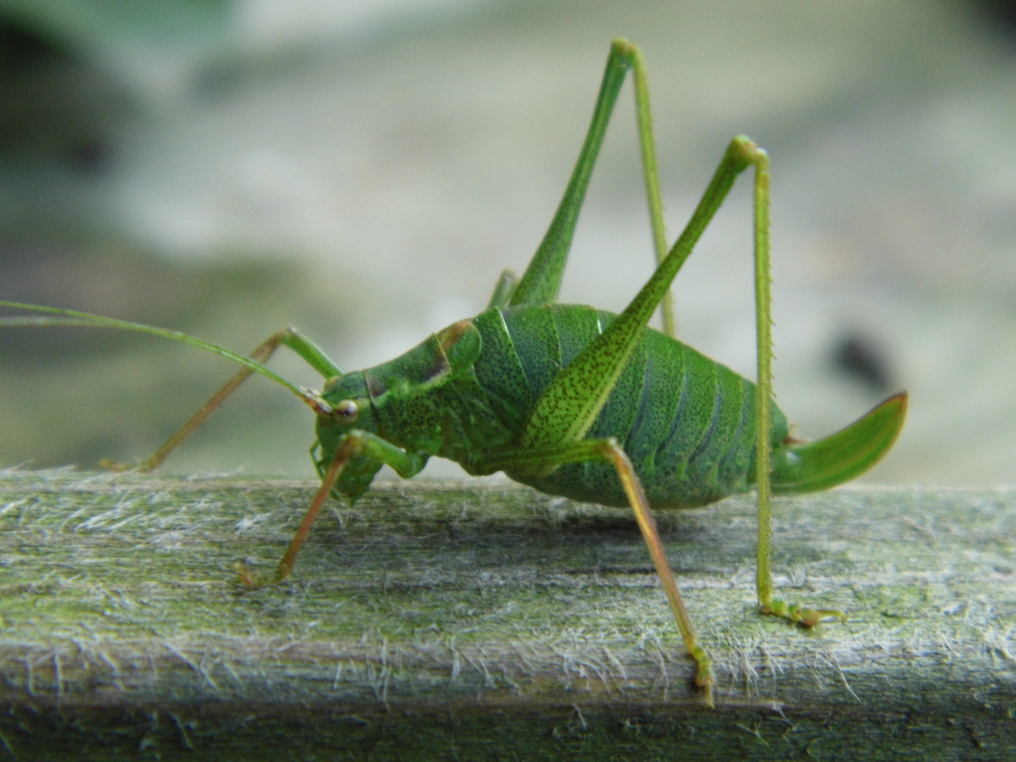
Bughunts, Butterflies and Beasties
Fun with wildlife!
With Rutland Natural History Society
Come and join in
Saturday July 20th
^{At Ketton Scout Hut}
^{Pit lane Ketton}
^{11-12.30 and 1.30-3.00pm}
^{Children £3 per session}
Must be accompanied by an adult ^{Members free}
To book email rnhsmammals@talktalk.net
For more details see website www.rnhs.org.uk

